Slide 1

MANUFACTURING ANALYSIS
BY
ABHISHEK NEERLAGI

Slide 2
INTRODUCTION
The manufacturing industry produces clothing and accessories through various stages, including design, fabric sourcing, cutting, sewing, and finishing. It operates globally and caters to diverse consumer preferences.
This project aims to innovate and improve manufacturing processes to enhance efficiency, sustainability, and competitiveness within the industry.

Slide 3
PROCESS
The data was found in a text form and we did ,cleaning inconsistencies, transforming it into a usable format, and structuring it for efficient analysis.
We planed the layout, we selected suitable visualizations (charts, gauges), and incorporate interactivity to make the dashboard user-friendly and informative. Decided where each KPI, chart, and slicer will be placed.
Based on the requirements, we created the charts and visualizations using the manufactured dataset.
We did all the necessary calculations according to the business requirements.

Slide 4
OBJECTIVES
Track total Manufactured Quantity over time.
Monitor Rejected Quantity to identify quality issues.
Measure Processed Quantity as a key production metric.
Calculate and track Wastage Quantity to reduce waste.
Analyze Employee-wise Rejected Quantity to find training or process gaps.
Review Machine-wise Rejected Quantity to detect equipment-related problems.
Observe Production Comparison Trend to see how production performance changes over time.
Analyze Department-wise Manufacture vs. Rejected Quantity to identify departmental efficiency.
Compare Manufacture vs. Rejected Quantity to monitor rejection rate.

Slide 5
DATA OVERVIEW
This dataset captures detailed daily manufacturing data, including buyer and customer details, department-wise production records, employee information, processed and produced quantities, costs, and total order values—providing a comprehensive view of operational performance.
The 'MANUFACTURING DATASET' file has 10679 rows and 68 columns.
The dataset includes a 'Machine Name' column, which lists the names of various machines used in the manufacturing process , based on the dataset we have total 87 Machines.
The total number of unique employees in the provided dataset is 129.
Based on the provided dataset, the month in which the whole manufacturing activity is predominantly done is November.
Date and Time Information ,The dataset includes various date and time columns such as Doc Date, End Time, Fiscal Date, Fiscal DateTime, SO Del Date, SO Delivery Date, SO Docdate, SO DocDate F, SO Expected Delivery F, So Posting Date, Start Time,U_GRCDate, and WO Date .which can be used to analyze production trends over time
Production quantities are recorded in Balance Qty, Manufactured Qty, Press Qty, Processed Qty, Produced Qty, Rejected Qty, today Manufactured qty. The Man/Rejc and Rejected Qty columns indicate quality control aspects. while Final Processed Qty and Is Final Process track the completion of production stages

Slide 6
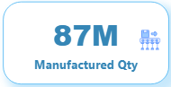
MANUFACTURED QTY
The total quantity of items produced within a specific time frame.
Indicates the volume of output from the manufacturing process.
Card showing production quantity over time.
Tracking the manufacture quantity over time can reveal production trends, such as seasonality or periods of high demand.
Identify peak production periods to optimize resource allocation and scheduling.

Slide 7
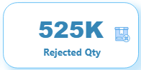
REJECTED QTY
The quantity of items rejected during the manufacturing process due to defects or quality issues.
Reflects the effectiveness of quality control measures.
Card showing rejected quantity to total production.
Monitoring rejected quantity helps identify quality issues in the manufacturing process.
Investigate root causes of rejected items to implement corrective actions and improve quality control procedures.

Slide 8
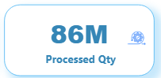
PROCESSED QTY
The quantity of items successfully completed through the manufacturing process.
Indicates the portion of production meeting quality standards.
Card illustrating the total processed quantity.
Comparing processed quantity to total production indicates the efficiency of the manufacturing process.
Streamline production processes and reduce cycle times to increase the proportion of processed quantity.

Slide 9
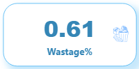
WASTAGE QTY
The quantity of materials wasted during the manufacturing process.
Highlights inefficiencies in material usage and production processes.
Card showing the breakdown of waste by material type.
Analyzing wastage quantity highlights inefficiencies in material usage and production processes.
Implement waste reduction strategies such as lean manufacturing principles or recycling initiatives to minimize wastage.

Slide 10
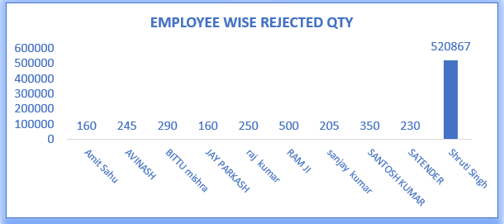
EMP_WISE REJECTED QTY
The quantity of rejected items attributed to individual employees.
Identifies training needs or performance issues among employees.
Column chart showing ranking employees by rejected quantity.
Identifying employees with high rejected quantities can indicate training needs or performance issues.
Provide targeted training and performance feedback to improve employee skills and reduce rejected quantity.

Slide 11
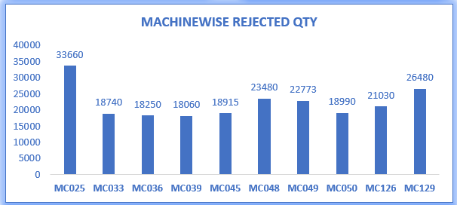
MACHINE_WISE REJECTED QTY
The quantity of rejected items attributed to specific machines.
Helps optimize machine utilization and maintenance schedules.
Chart showing the machines with the highest rejected quantity.
Machines with high rejected quantities may indicate maintenance issues or inefficiencies in operation.
Schedule preventive maintenance and optimize machine utilization to reduce rejected quantity and downtime.

Slide 12
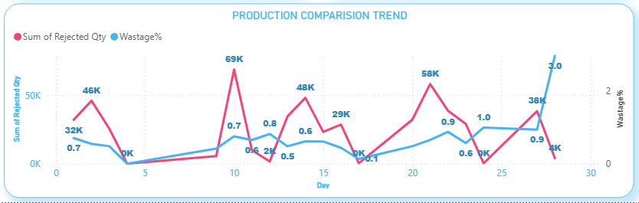
PRODUCTION COMPARISON TREND
Analysis of production quantities over time to identify trends and patterns.
Provides insights into production fluctuations and seasonality.
Line graph showing production trend over multiple time periods.
Analyzing production trends over time reveals patterns and seasonality in demand.
Adjust production schedules and inventory levels to meet fluctuating demand

Slide 13
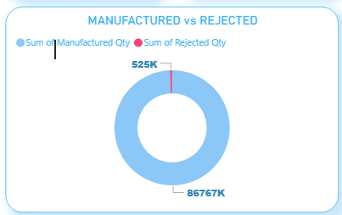
REJECTED vs MANUFACTURED
A comparison between total manufactured quantity and total quantity rejected.
Evaluates the efficiency and quality of the manufacturing process.
Donut chart comparing the percentages between manufactured and rejected quantities.
Comparing manufactured quantity to rejected quantity provides insights into the effectiveness of quality control measures.
Set quality targets and implement continuous improvement initiatives to reduce the proportion of rejected quantity.

Slide 14
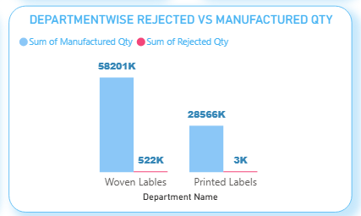
DEPT_WISE REJECTED vs MANUFACTURED
Breakdown of manufactured and rejected quantities by department.
Identifies areas for improvement and allocation of resources.
Clustered column chart comparing manufactured and rejected quantities by department.
Variations in manufacture and rejected quantities among departments indicate areas for improvement.
Allocate resources and prioritize quality improvement efforts based on departmental performance.

Slide 15
SUMMARY
At 92,52,803, 10-11-2015 had the highest Sum of Manufactured Qty and was 1,052.74% higher than 12-11-2015, which had the lowest Sum of Manufactured Qty at 8,02,677.
10-11-2015 accounted for 10.66% of Sum of Manufactured Qty.
﻿Across all 11 Emp Name, Sum of Rejected Qty ranged from 130 to 500.
Sum of Manufactured Qty and total Sum of Rejected Qty are positively correlated with each other.
Sum of Manufactured Qty and Sum of Rejected Qty diverged the most when the Department Name was Woven Lables, when Sum of Manufactured Qty were 57,679,298 higher than Sum of Rejected Qty.

Slide 16
CONCLUSION
Monitoring the manufacture quantity provides insights into production volumes, enabling efficient resource allocation and scheduling to meet demand.
Analyzing rejected quantity helps identify areas for quality improvement, leading to reduced waste, improved product quality, and enhanced customer satisfaction.
Tracking processed quantity indicates the efficiency of manufacturing processes and highlights areas for optimization to increase throughput and reduce cycle times.
Understanding wastage quantity allows for the identification of inefficiencies in material usage and production processes, facilitating waste reduction initiatives and cost savings.
Employee-wise rejected quantity data aids in identifying training needs and performance issues, enabling targeted interventions to improve employee skills and reduce defects.
Machine-wise rejected quantity insights facilitate maintenance scheduling and operational improvements to minimize downtime, enhance machine efficiency, and reduce rejection rates.
Analysis of production comparison trends over time enables proactive adjustments to production schedules and resource allocation to meet changing demand patterns efficiently.
Comparing manufacture and rejected quantities provides a holistic view of production quality, guiding efforts to reduce rejection rates and improve overall process efficiency

Slide 17
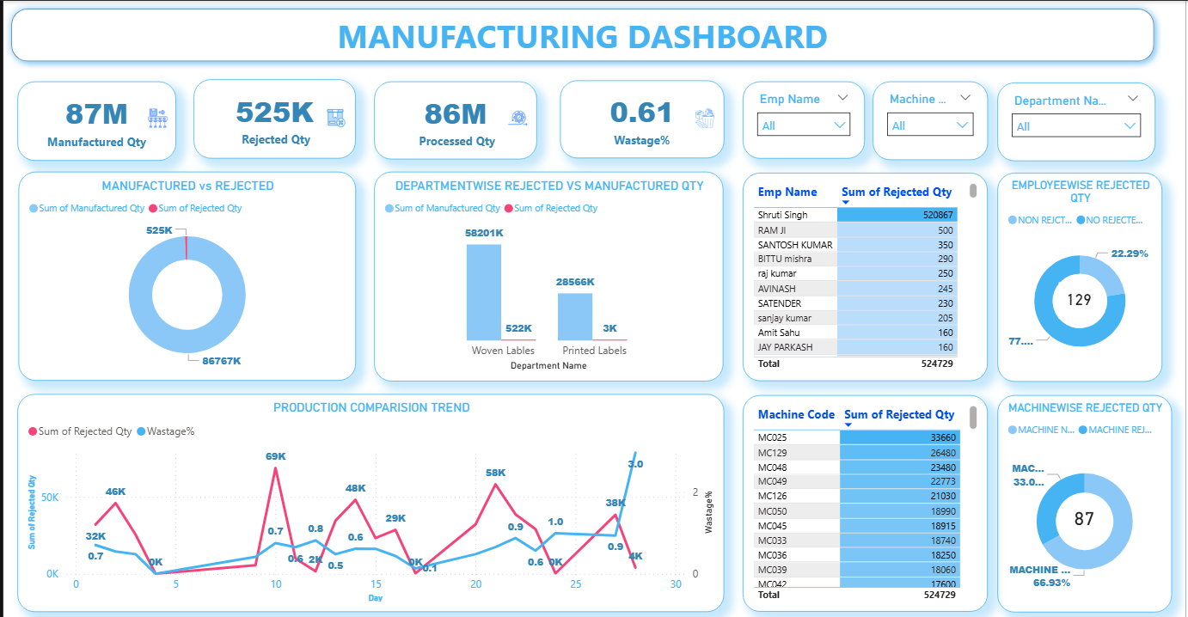

Slide 18
THANK YOU

